Slide 1

ANZ Virtual Internship Program
Task 1: Exploratory Data Analysis
Kasun Bandara
PhD Student
Monash University, Melbourne

Slide 2
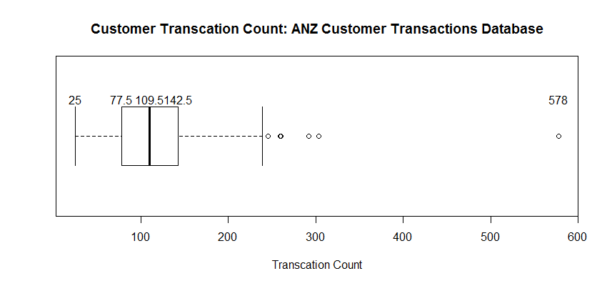
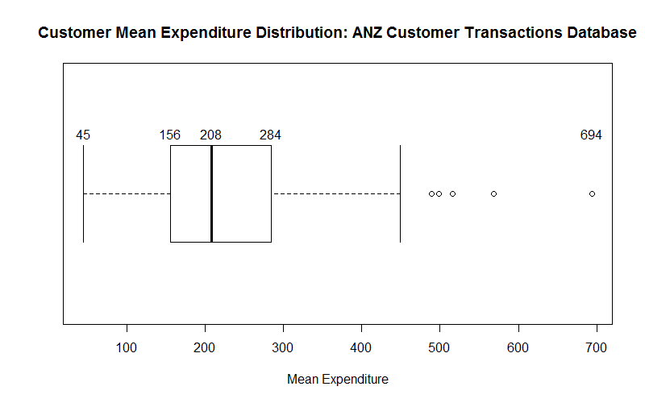
Exploratory Data Analysis : ANZ Customer Database
The left box plot illustrates the transaction count of each customer (100) over the 3 months of time period, whereas right box plot represents the average transaction value (amount) of the customers.
Mean of the transactions count and the average of transaction values are 120 and $228 (rounded) respectively.
From the 2 Box-pots it’s clear that there are five customers (outliers), who have a high percentage of transaction volume and expenditure.
These customers can be specifically targeted for marketing campaigns/special offers etc.

Slide 3
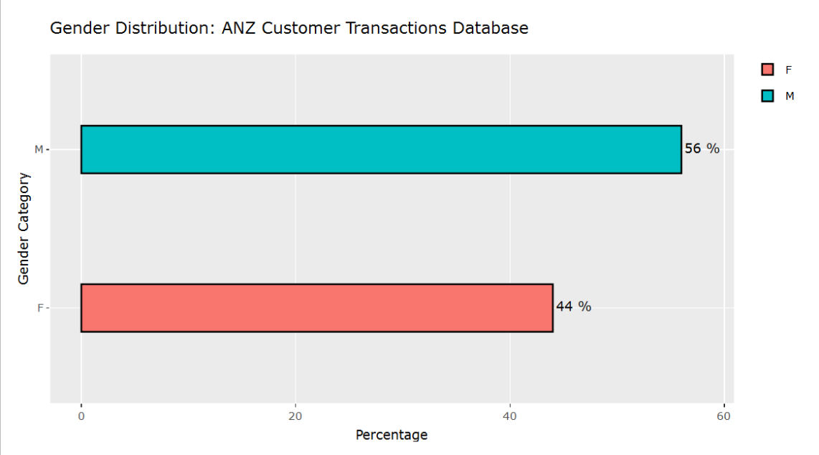
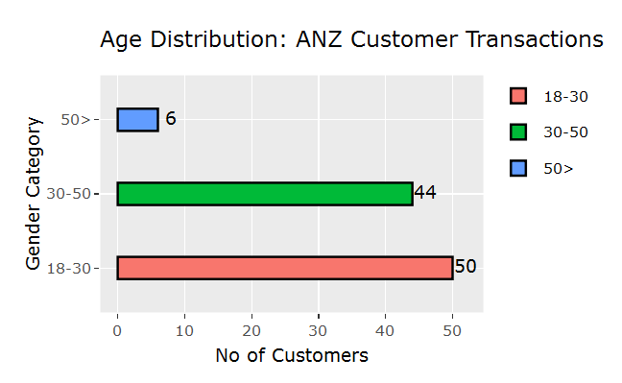
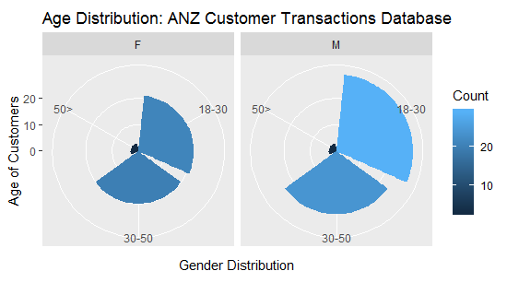
Demographic Analysis : ANZ Customer Database

Slide 4
Demographic Analysis : Key Highlights
Among 100 customers in the database, majority of the customers are “Male”
Also, majority of the customers in the database falls into the age category of “18-30” and a combination of the age categories of “18-30” and “30-50”, represents 94% of the customers in the customer database (I created a new column called “Age Category”, using the “age” variable)
Accordingly the Pie chart, it’s quite evident that the “18-30” age category individuals are mostly “Male”
In next the next slide, we explore the transaction frequencies of these gender types and age categories.
This would be useful from the ANZ perspective to initiate marketing campaigns aiming these specific groups.

Slide 5
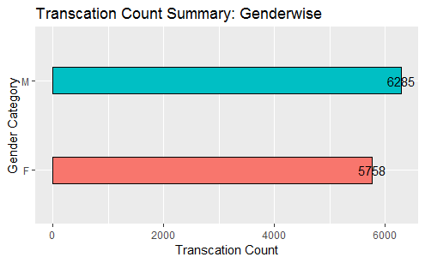
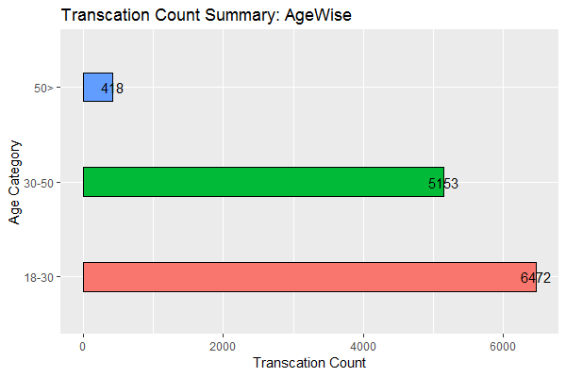
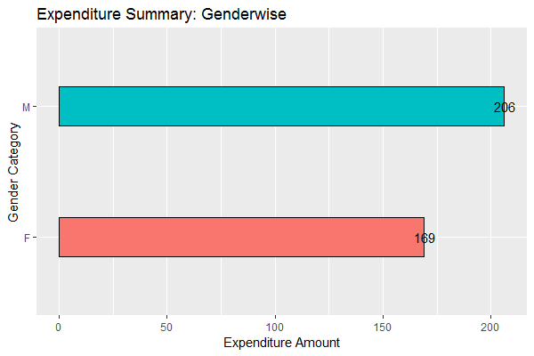
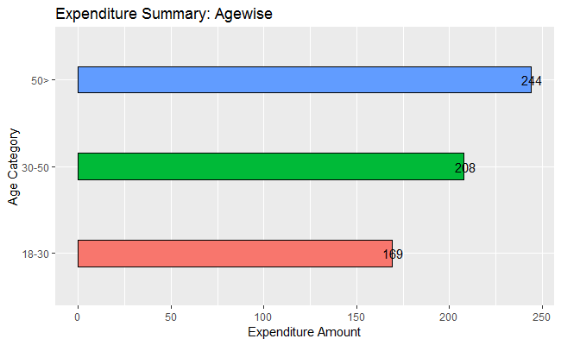
Transaction Summary: ANZ Customer Database

Slide 6
Transaction Summary : Key Highlights
Following the same conclusions from the demographic analysis, the gender category “Male” creating high proportion of the transaction volume and mean value of expenditure as well.
A very interesting observation in Age wise transaction value. Even though, in terms of the transaction volume the age category “>50” showing lesser number of proportion, when it comes to mean value of expenditure, this category has surpassed the other two age category types. This is would be a interesting finding for the ANZ and would be worthwhile to dig into more.
Having the feature “Expense type” of these transactions would have been beneficial to draw additional insights on these expense distributions.
In the next slide, we explore the daily, weekly, monthly transaction volume and value (expenditure) in the database

Slide 7
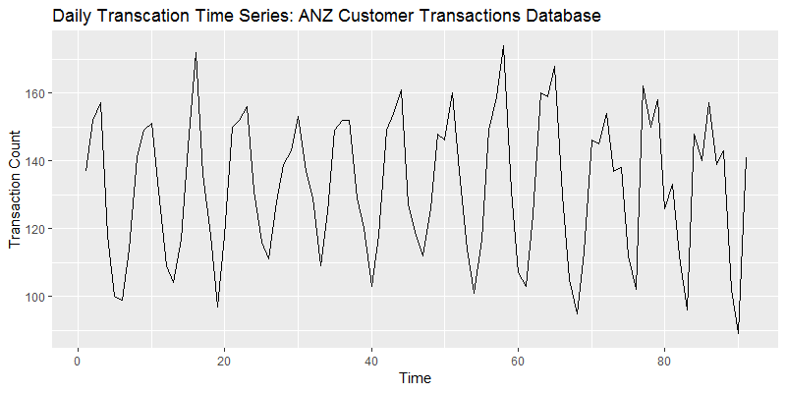
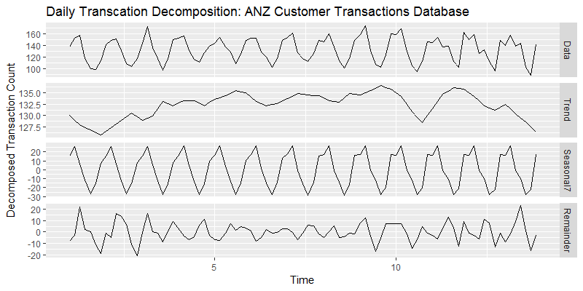
Daily Transaction Volume Time Series
Daily Transaction Volume Time Series
Mean: 132
Median: 136
Time Series Decomposed into Trend, Seasonality, and Remainder

Slide 8
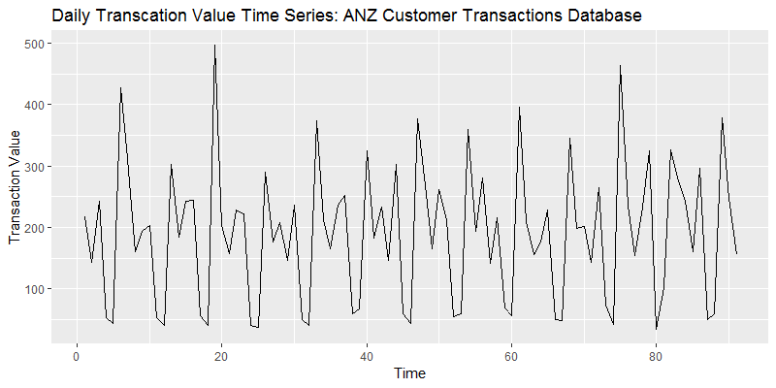
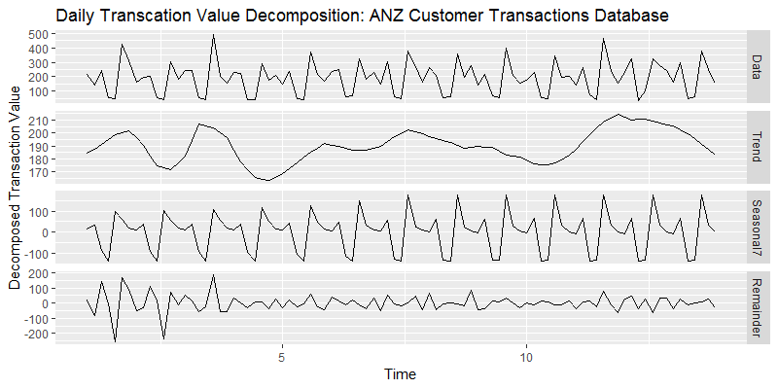
Daily Mean Transaction Value Time Series
Daily Transaction Mean Value Time Series
Mean: $ 191
Median: $ 198
Time Series Decomposed into Trend, Seasonality, and Remainder

Slide 9
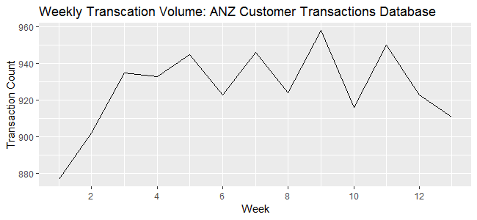
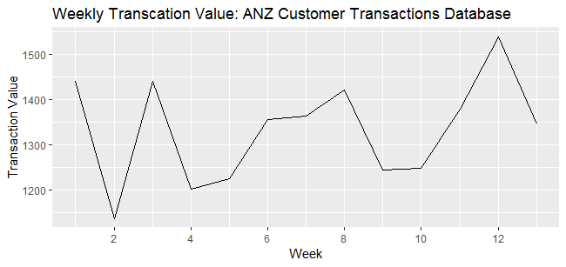
Weekly Transaction Time Series
Daily Transaction Volume Time Series
Mean: 926
Median: 924
Daily Transaction Mean Value Time Series
Mean: $ 1334
Median: $ 1355

Slide 10
Daily and Weekly Transaction Time series : Key Highlights
For the duration of 91 days, both daily time series (transaction volume and mean value) appear to have a very strong weekly seasonality. This is can be due to the high level of transactions happening in the weekend (Entertainment, Food, Shopping etc.)
The Daily time series are decomposed to identify the possible seasonal patterns and trends in the time series.
These values need to be carefully analysed since the there are several customers who are spending a lot compared to others (outliers)
Some interesting observation in the weekly transaction time series, where in the week 1-2, though the overall transaction volume is increasing, the mean value of the transaction is declining. This needs to be investigated thoroughly, may be using more attributes of these transactions.

Slide 11
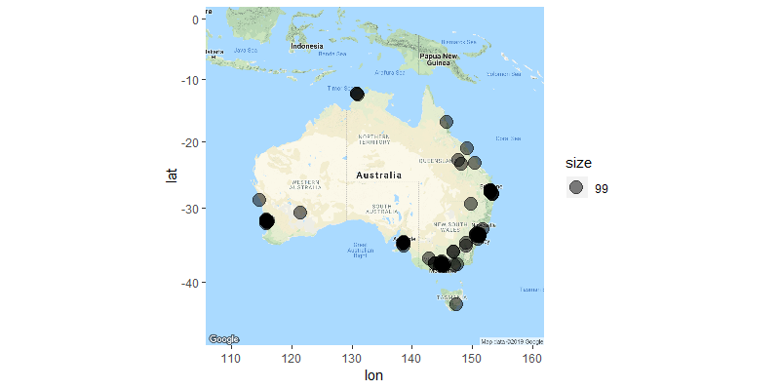
Exploiting Location Data : Australia
Using ‘long_lat’ variable to summarise the geographical dispersion of the customers in the database (Assuming this variables denotes the customer locations as there are 100 unique Longitude and Latitude pairs, which is equivalent to the customer base)
An unusual observation of Longitude and Latitude was removed, hence 99 data observations are illustrated.
A Large customer base resides in Melbourne and Sydney. Comparatively lesser customer density in the Western part of Australia.

Slide 12
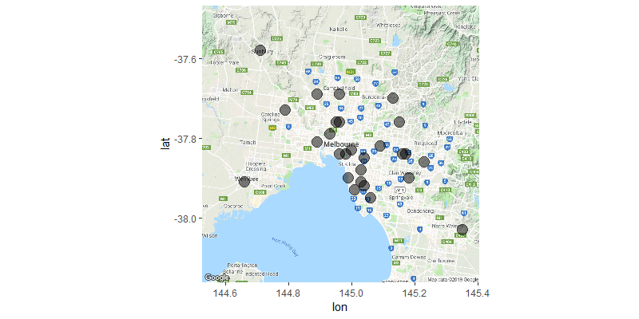
Exploiting Location Data : Melbourne
As a large customer base resides in Melbourne, a separate sub map is generated to illustrate the distribution of the Melbourne customers.
Higher customer density around the Melbourne CBD and a lesser customer density in the Melbourne rural suburbs.

